Slide 1
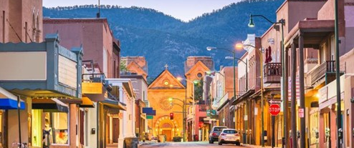

Bobby Orwig – Energy Engineer

Slide 2

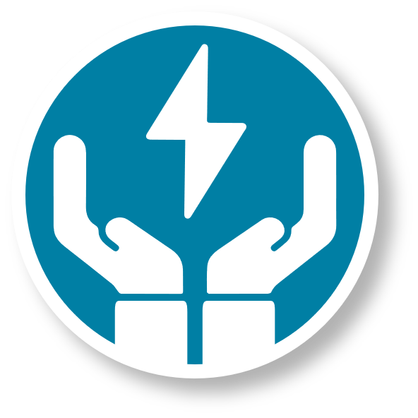

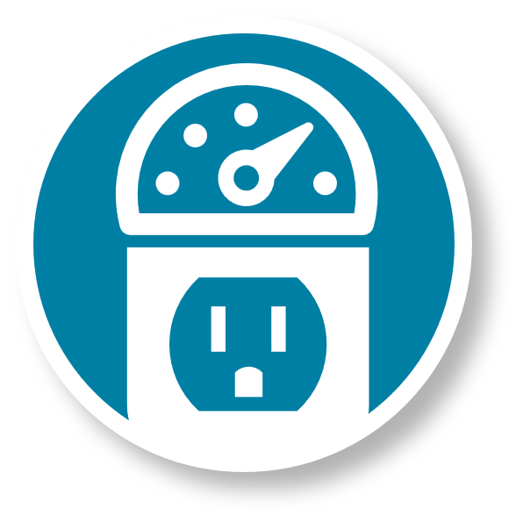
2025 Business Program Goals
This year’s assigned goal is to deliver:
46,086,269
in kWh savings
$6,165,994
in rebate dollars
13.4¢
per kWh

Slide 3





2024 Environmental Impact
Together, last year we saved enough energy to power
3,631
NM homes for a year
Keeping
26,042
metric tons of CO₂ from being released into the air
Reducing emissions from
6,074
gasoline-powered passenger vehicles
https://www.epa.gov/energy/greenhouse-gas-equivalencies-calculator

Slide 4

Programs at a glance
Retrofit Rebate
New Construction
Quick Saver
Cash rebates reduce the up-front cost of eligible energy efficiency improvements in existing buildings.
Qualify for PNM rebates when implementing more efficient building designs that exceed baseline energy efficiency code requirements.
Small business customers with peak demand under 200 kW can qualify for higher rebates and turnkey installation.
Multifamily Program
Building Tune-Up
Distributor Discount
Multifamily communities can get rebates for in-unit and common areas, plus bonuses for income qualified communities.
Commercial building owners and operators can get support and rebates for optimizing their building’s performance and improving system efficiency.
Receive instant, point-of-sale rebates on qualifying high-efficiency commercial food service and HVAC equipment sold by authorized distributors.
pnmenergyefficiency.com

Slide 5


Quick Saver means small business
The Quick Saver program is designed to promote the installation of energy-efficient measures in small businesses.
Who is a Quick Saver customer?
An active business receiving commercial electric service from PNM for at least six months
On Small Power rate – or, if on billable demand rate, has a maximum 12-month average usage of 200 kW or less

Slide 6

Quick Saver customer benefits
Free lighting assessment by an energy efficiency professional
Detailed proposal – know what to expect
Professional installation of qualified energy-saving equipment
Program inspections that assure quality and verify estimated savings
Lower electric consumption
Incentives can cover 50% or more of project cost
Average payback time: 1-2 years

Slide 7

Rebate programs to help New Mexico businesses save energy and money.
Implementor: DNV Energy Services USA Inc.
Phone: 505-938-9400
Email: energyefficiency@pnm.com
Web: pnmenergyefficiency.com
Find a Contractor: pnmenergyefficiency.com/findacontractor
Online Application: eeready.pnm.com

Slide 8


Q&A

Slide 9
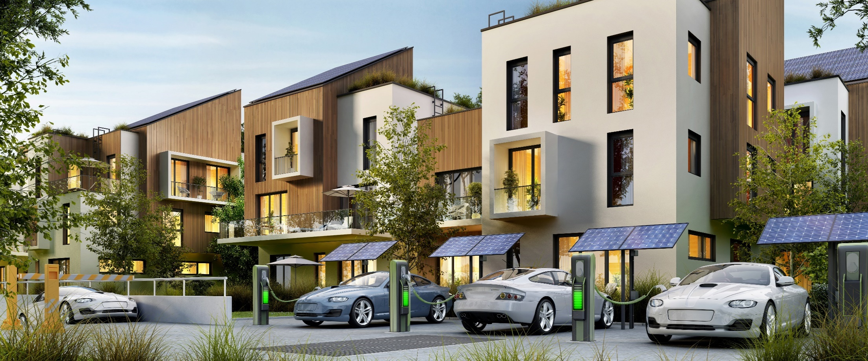
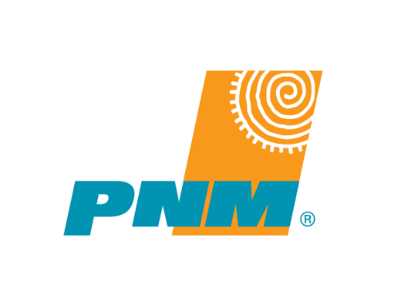
Supporting Ev charger deployments
Richmond Larbi – EV Engineer

Slide 10
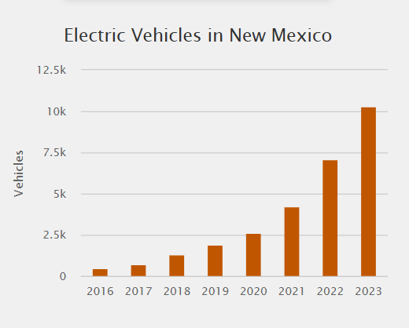
Trends in electric vehicles
EV stocks growing 23% annually from 2023 to 2035 - IEA
The growing momentum needs to be met with:
Growing infrastructure
Energy planning

Slide 11
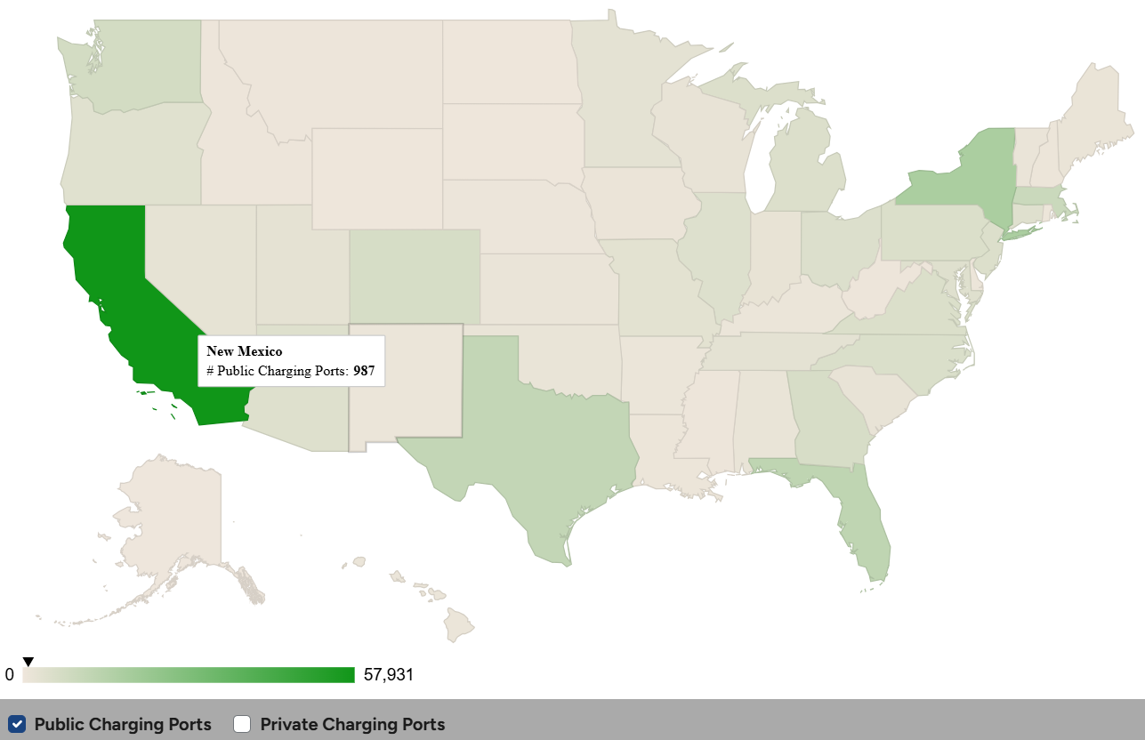
Electric vehicle charging infrastructure
Public charging projected to increase sixfold
Home charger owners still rely on public chargers

Slide 12
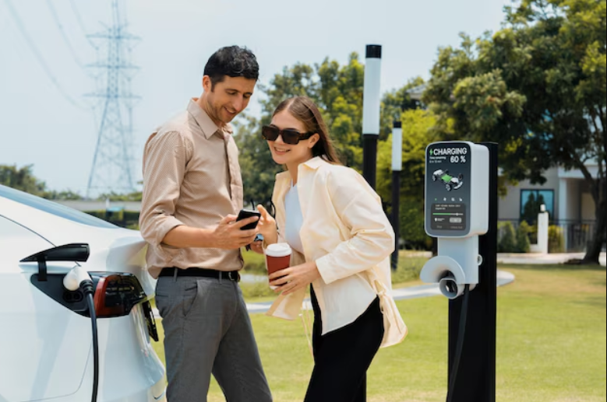
Hotel EV chargers
A modern necessity:
Improving guest experience
Future-proofing your business

Slide 13
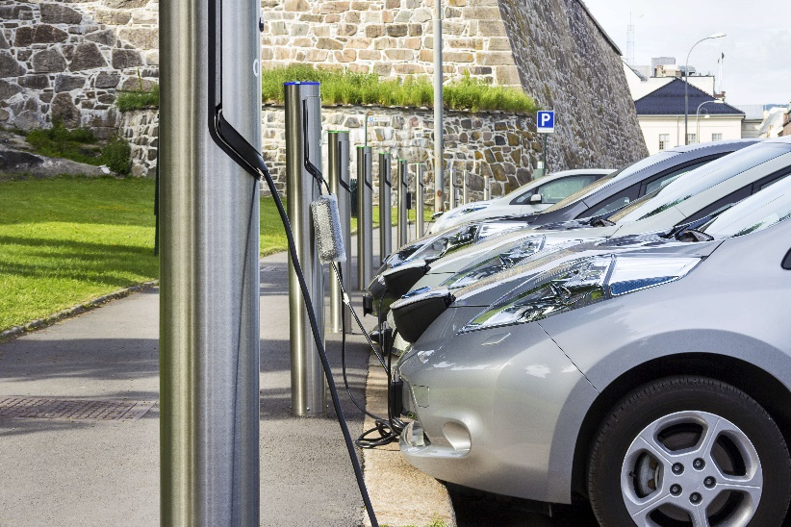
Electric vehicle charger rebates
Level 2 and Level 3 (DCFC)
Commercial
Up to $5,000 per port of Level 2 charger
Up to $50,000 per unit of Level 3 charger
Residential
Up to $500 per Level 2 charger
Up to $1,500 installation cost

Slide 14

Rebate programs to help New Mexico residents and businesses overcome barriers to EV adoption.
Implementor: DNV Energy Services USA Inc.
Phone: 505-355-6286
Email: TEP@pnm.com
Web: ev.pnm.com
Find a Contractor: ev.pnm.com/easy-install

Slide 15
Q&A

Slide 16

Thank You

